Slide 1
Subhranil Sarkar
Artificial Intelligence and Data Mining
2nd Semester | M.Sc. Data Science
Roll: 96/DTS No.: 210018
Reg. No.: 020873 of 2018-2019
University of Kalyani

Slide 2
Index
Breadth First Search
Depth First Search
Genetic Algorithm
Decision Tree
Support Vector Machine

Slide 3
Breadth First Search

Slide 4
Process
Breadth first Search is a simple graph-search technique.
Root node is expanded first, then all the successors of root node are expanded next, then their successors, and so on.
All the nodes at a certain depth are expanded first before any nodes at the next level. That’s why it is called “Breadth” First Search.
1

Slide 5
Process
Shallowest unexpanded node is always chosen for expansion.
This is done by using a FIFO queue at the frontier.
Thus new nodes go to the back of the queue, and old ones, which are shallower than the new nodes, get expanded first.
Always checks if the generated nodes are goal node or not.
Using explored set to store all the visited nodes.
Using frontier and explored set we always get the shallowest path in this search algorithm.
2

Slide 6
Implementation
function BFS(graph, start, goal) returns a solution, or failure
node ← start state, path-cost = 0
if initial is goal then return node
frontier ← FIFO queue with the node
explored ← an empty set
loop do
if isEmpty(frontier) then return failure
node ← pop(frontier) /* shallowest node */
explored.add(node)
for each child in expand(node) do
if child is not in explored or frontier then
if child is goal then return path(start, child)
frontier.insert(child)
3

Slide 7
Depth First Search

Slide 8
Process
Depth-First Search is a graph-search algorithm.
Always expands the deepest node in the current frontier.
The search proceeds immediately to the deepest level of the search tree, where the nodes have no successors.
After expanding the nodes, they are dropped from the frontier.
So the previous deepest node that still has unexplored successors will expand.
4

Slide 9
Process
The most recent unexpanded node is always chosen for expansion.
This is done by using a LIFO queue at the frontier.
Two versions of DFS are there: graph-search and tree-search depending on whether the explored states are recorded or not.
Graph-search version is complete in finite space.
DFS is nonoptimal.
5

Slide 10
Implementation
function DFS(graph, start, goal) returns a solution, or failure
node ← start state, path-cost = 0
frontier ← LIFO queue with the node
explored ← an empty set
loop do
if isEmpty(frontier) then return failure
node ← pop(frontier) /* shallowest node */
if node is goal then return path(start, node)
explored.add(node)
for each child in expand(node) do
if child is not in explored or frontier then
frontier.extend(child)
6

Slide 11
Genetic Algorithm

Slide 12
Process
Genetic Algorithm is inspired by Charles Darwin’s theory of natural evolution.
Successor states are generated by combining two parents.
Chromosome: randomly generated binary string of a random size.
Population: k randomly generated chromosomes.
Fitness: From a given function we have to evaluate fitness of a chromosome.
Selection: Select best chromosomes and create a mating pool.
7

Slide 13
Process
Crossover: Select two random chromosomes and select a random point in the chromosome and exchanged parts of the chromosomes to create children.
Mutation: With a mutation probability, flip a bit from the chromosome, which resembles mutation in the biology.
Elitism: Carry the parent to the new population if the greatest fitness of the newly generated population is less than the previous population.
8

Slide 14
Implementation
function GA(popSize, chromLen, maxIter, crossProb, mutProb)
population ← makePopulation(popSize, chromLen)
fit ← fitness(population)
for (i = 0; i < maxIter; i = i + 1) do
matingPool ← selection(population)
crossPopulation ← crossover(matingPool, crossProb)
mutatedPopulation ← mutation(crossPopulation, mutProb)
childBestFit ← fitness(mutatedPopulation)
oldBest ← best(fit)
newBest ← best(childBestFit)
if oldBest >= newBest then exchange(oldBest, newBest)
population ← mutatedPopulation
fit ← childBestFit
return bestChrom(population)
9

Slide 15
Decision Tree

Slide 16
Process
Decision Tree is a Supervised learning technique that can be used for both classification and Regression problems, but mostly it is preferred for solving Classification problems.
A decision tree is a flowchart-like tree structure, where each internal node (non-leaf node) denotes a test on an attribute, each branch represents an outcome of the test, and each leaf node (or terminal node) holds a class label.
The topmost node in a tree is the root node.
The decisions or the test are performed on the basis of features of the given dataset.
In order to build a tree, we use some algorithms which are ID3, C4.5, CART. This is called Decision Tree Induction.
ID3, c4.5, CART adopt a greedy approach in which decision trees are constructed in a top-down recursive divide-and-conquer manner.
10

Slide 17
Process
To determine the best split, using greedy approach nodes with homogeneous class distribution are preferred.
Measures of Node impurity are:
Gini Index
Entropy
Gain Ratio
Stopping Criteria for tree induction:
Stop expanding a node when all the records belong to the same class.
When all the records have similar attribute value.
11

Slide 18
Implementation
create a node N;
if tuples in D are all of the same class, C, then
return N as a leaf node labeled with the class C;
if attribute list is empty then
return N as a leaf node labeled with the majority class in D; // majority voting
apply Attribute selection method(D, attribute list) to find the “best” splitting criterion;
label node N with splitting criterion;
if splitting attribute is discrete-valued and
multiway splits allowed then // not restricted to binary trees
attribute list ← attribute list - splitting attribute; // remove splitting attribute
for each outcome j of splitting criterion
// partition the tuples and grow subtrees for each partition
let Dj be the set of data tuples in D satisfying outcome j; // a partition
if Dj is empty then
attach a leaf labeled with the majority class in D to node N;
else attach the node returned by Generate decision tree(Dj, attribute list) to node N;
endfor
return N;
12

Slide 19
Support Vector Machine (SVM)

Slide 20
Process
Support Vector Machine (SVM) is a method for the classification of both linear and nonlinear data.
Uses a nonlinear mapping to transform the original training data into a higher dimension.
Within this new dimension, it searches for the linear optimal separating hyperplane (i.e., a “decision boundary” separating the tuples of one class from another).
The SVM finds this hyperplane using support vectors and margins (defined by the support vectors).
13

Slide 21
Process
SVM chooses the extreme points/vectors that help in creating the hyperplane.
These extreme cases are called as support vectors, and hence algorithm is termed as Support Vector Machine.
SVM can be of two types:
Linear SVM.
Non-linear SVM.
14

Slide 22
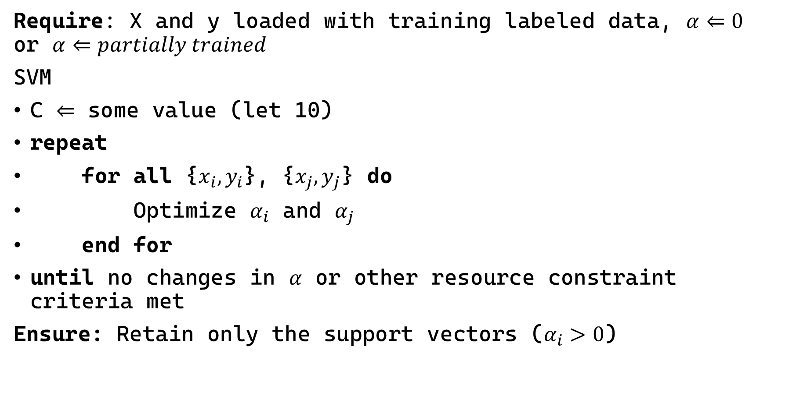
Implementation
Require: X and y loaded with training labeled data, $α⇐0$ or $α⇐partially trained$
SVM
C $⇐$ some value (let 10)
repeat
for all {$x_{i}, y_{i}$}, {$x_{j}, y_{j}$} do
Optimize $α_{i}$ and $α_{j}$
end for
until no changes in $α$ or other resource constraint criteria met
Ensure: Retain only the support vectors ($α_{i}>0$)
15

